Slide 1
Bike Data for Capital Bikeshare
Sal Pusateri

Slide 2

Overview
Project Overview
The data
Models
Results
Application/Constraints
Revenues/Costs
Conclusion

Slide 3
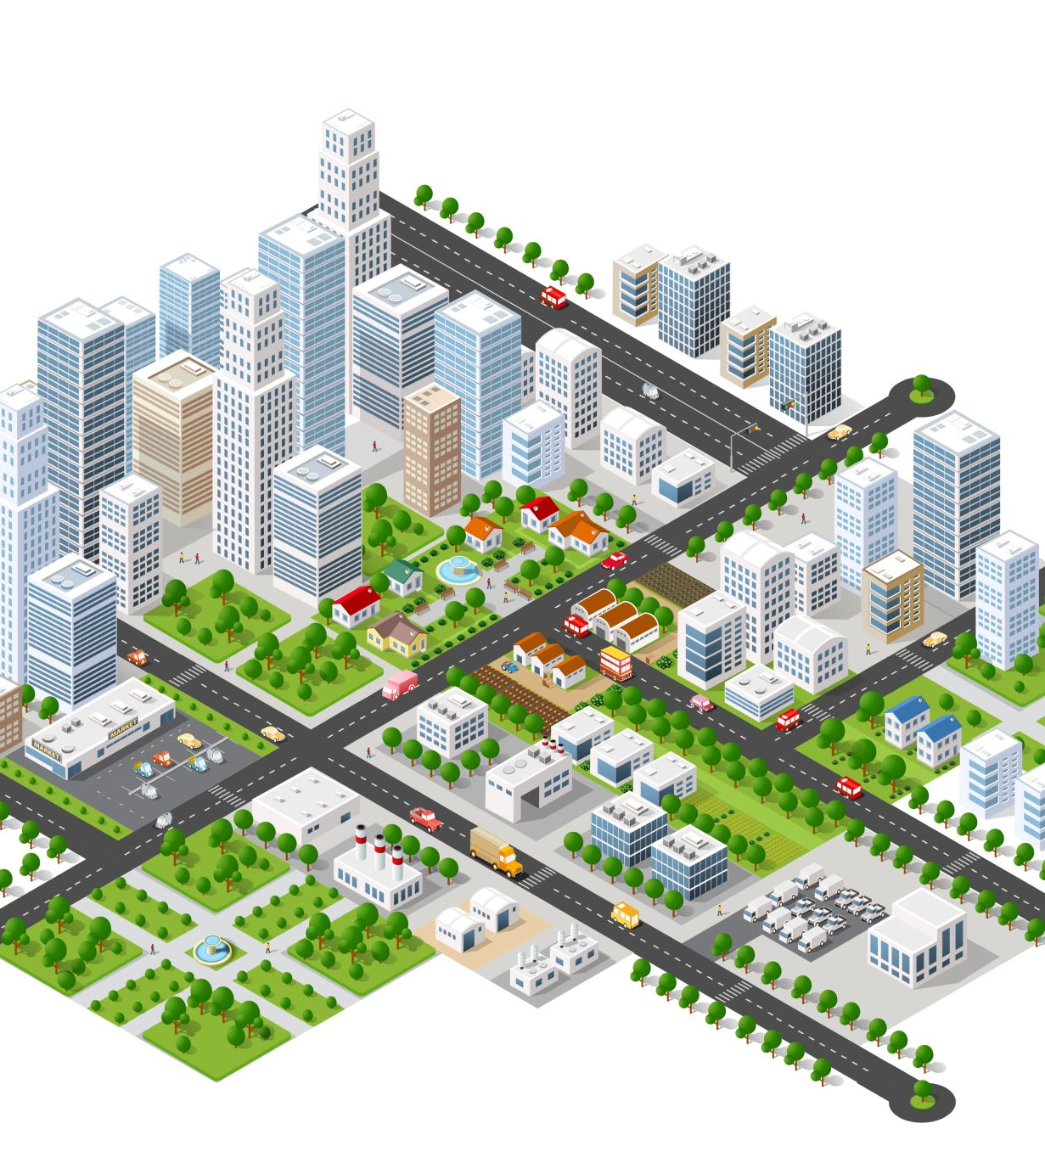
Project objectives
To review and report on any findings in the data pre-modeling
To construct predictive models on when rental bikes are utilized (rented) most to help with planning purposes in regards to expanding this project to more cities.
To check feasibility of these expansions, meaning if they are self sufficient or would require additional funding to cover the costs of implementation.

Slide 4
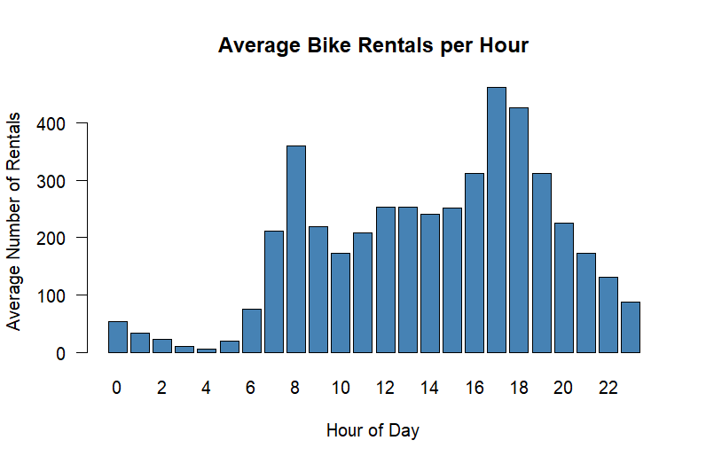
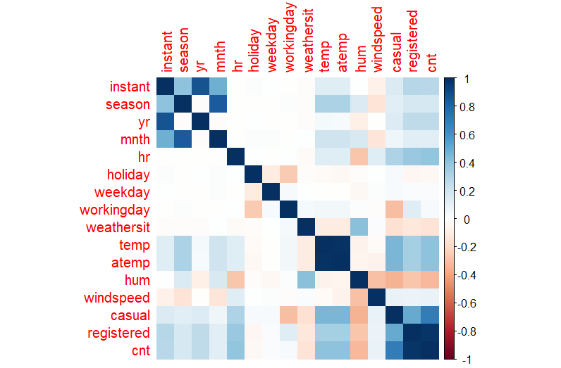
What does the data look like?

Slide 5
Models and accuracy
Random Forest model: r^2 of .9357, rmse of 45.8260
Gradient Boosting model r^2 of .9181, rmse of 51.6878

Slide 6
Results
There was between 4232-4496 bike rentals per season.
Both models scored very highly in predictive scale.
The hour of the day was most effective and the whether it was a work day, then week day were the top 3 predictors.

Slide 7

Application, what does this mean?
Many factors control people’s tendency to rent the bikes, most of which are unchangeable.
What can be changed then?

Slide 8
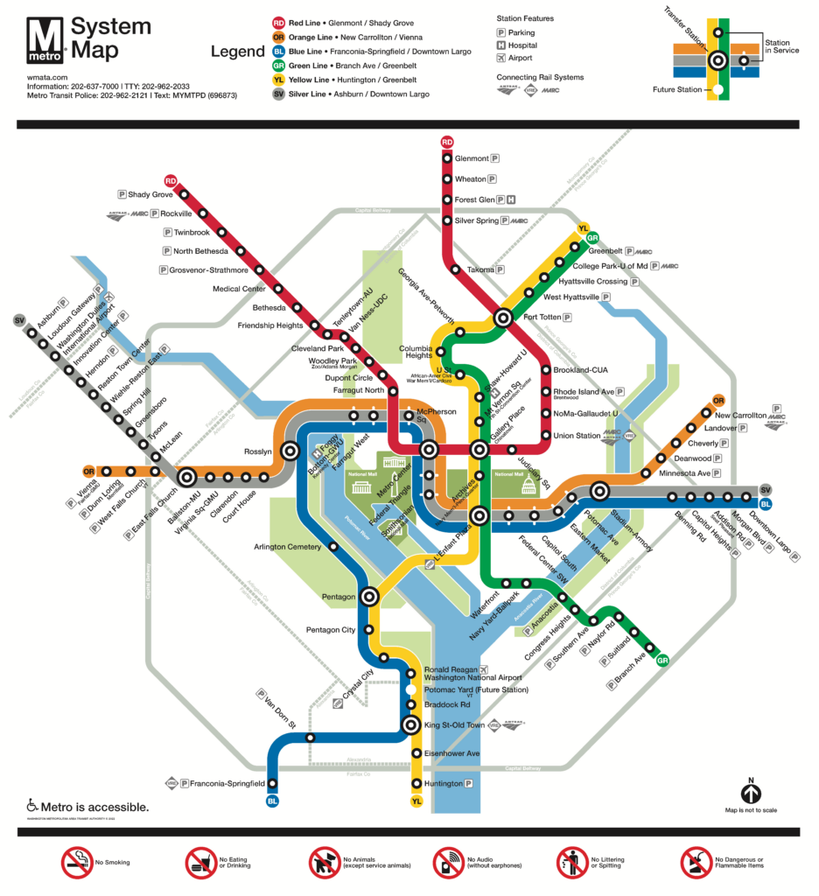
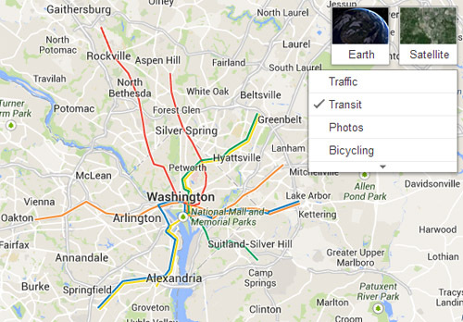
Maps for alternatives

Slide 9
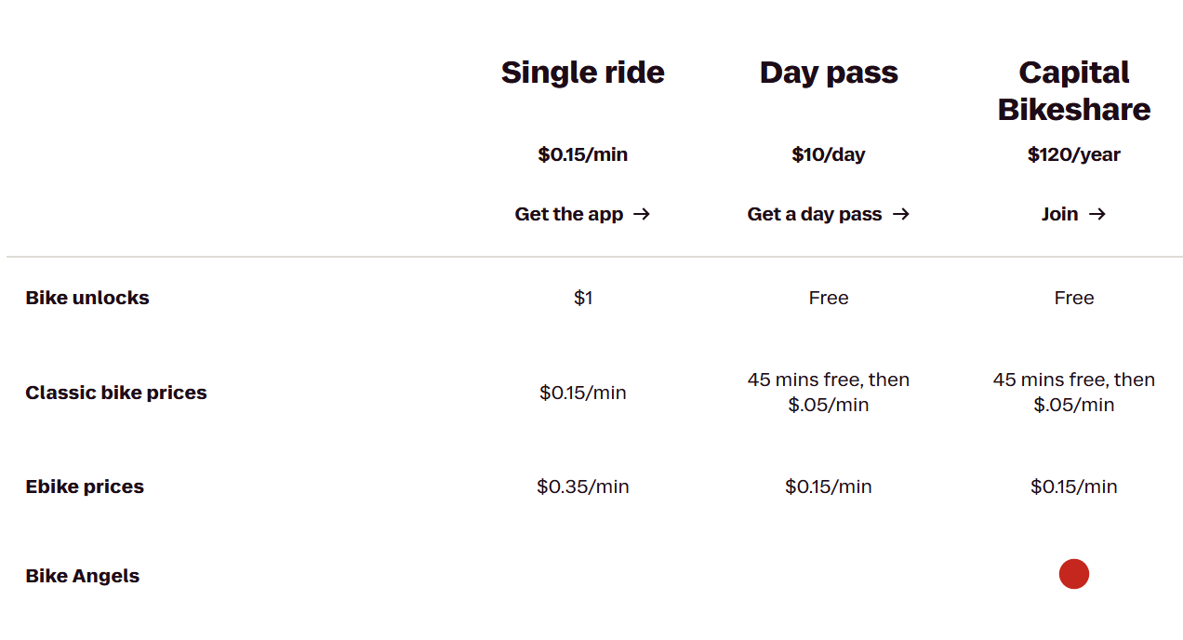
Economically speaking, what are we seeing?
Initial cost: $400–$800
Maintenance: $200-$300
Every bike needs to at least cover maintenance and pick up costs.

Slide 10

Conclusion
The system is effective and we can operate around peak usage times or lulls in the system.
The data was clean and we can effectively predict the rentals.
Finally, we can use this data for expansion or maximizing profits.

